Slide 1
Hello, Everyone!!
Welcome To My Presentation

Slide 2
Course Code : CSE 168
Project Name : Snake & Ladder Game (using c language with graphics)

Slide 3
Submitted By
Md. Mizanur Rahman
ID: 20131201035
Submitted to
Saleh ahmed
Associate professor
Dept. of CSE
BSMRSTU

Slide 4
Introduction
A game is a source of entertainment. A game gives us pleasure. Like other games my “Snake & Ladder Game” also gives us entertainment and pleasure.
Generally, Snake & Ladder Game is a game which is played with board and dice. But I try to make this different. That’s why I started to make this game. I use C language to make the game. I have to use graphics in this game.

Slide 5
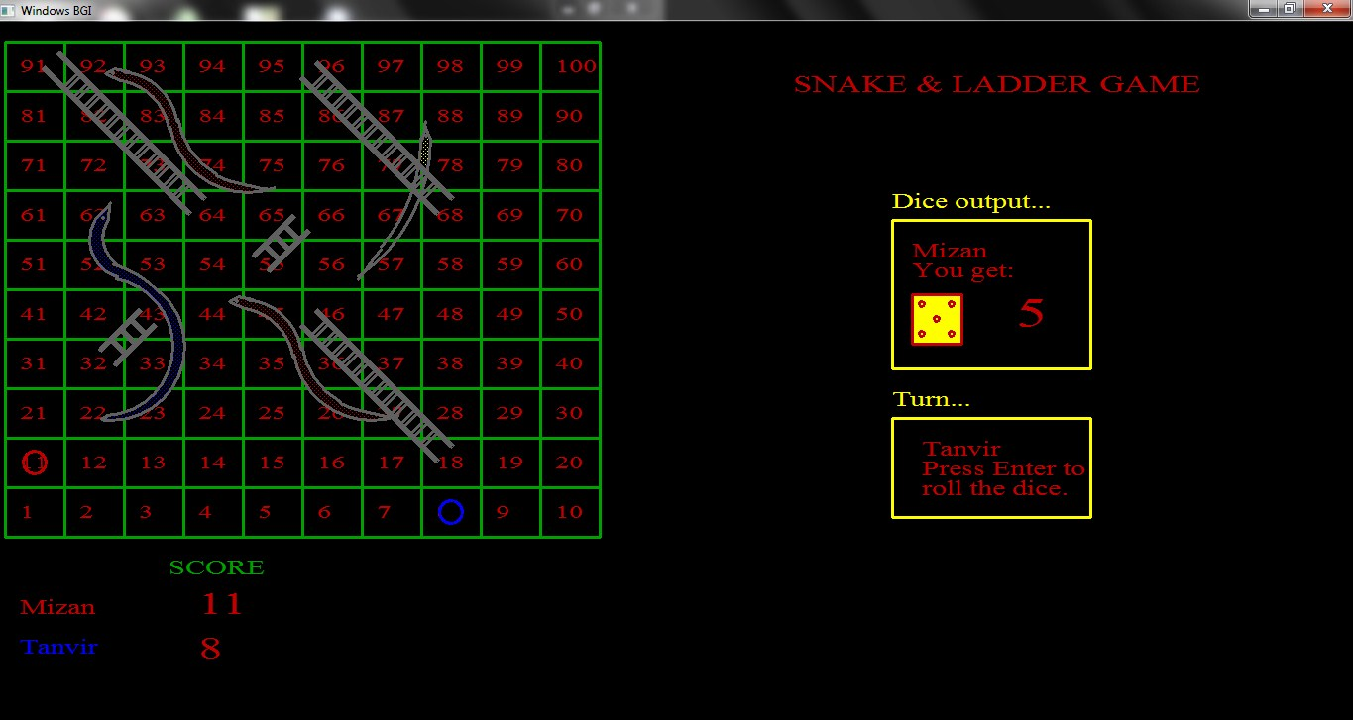
Snake & Ladder Game window

Slide 6
Related Work
It is a simple game project. It is made only for entertainment. So, this game has not other related work.
But it is only my first project. Next time I will try to make more efficient software.
I hope the next versions of this game will be contains some related work.

Slide 7
Implementation Details
Here you will be able to know about the implementation process of this game.
In my code, I use some user define function. Which make my task easier. This user define functions will help me to develop the game next time.

Slide 8
My user define functions are:
int welcome();
int board();
int ladder1();
int ladder2();
int snake1();
int snake2();
int snake3();

Slide 9
int numbering();
int random();
int status();
int dispdice(int dice);
int guti1(int num);
int guti2(int num);
int clrguti(int num);
int play();

Slide 10
User Manual
Here player can learn the process of controlling the game.
“Snake & Ladder Game” is an easy game to play. First a welcome screen will be appear. When “Snake & Ladder Game” board will appear, then you have to enter the players name on the .exe file, which is located behind the game screen.

Slide 11
The dice output box will show the dice and the number which you got by rolling the dice.

Slide 12
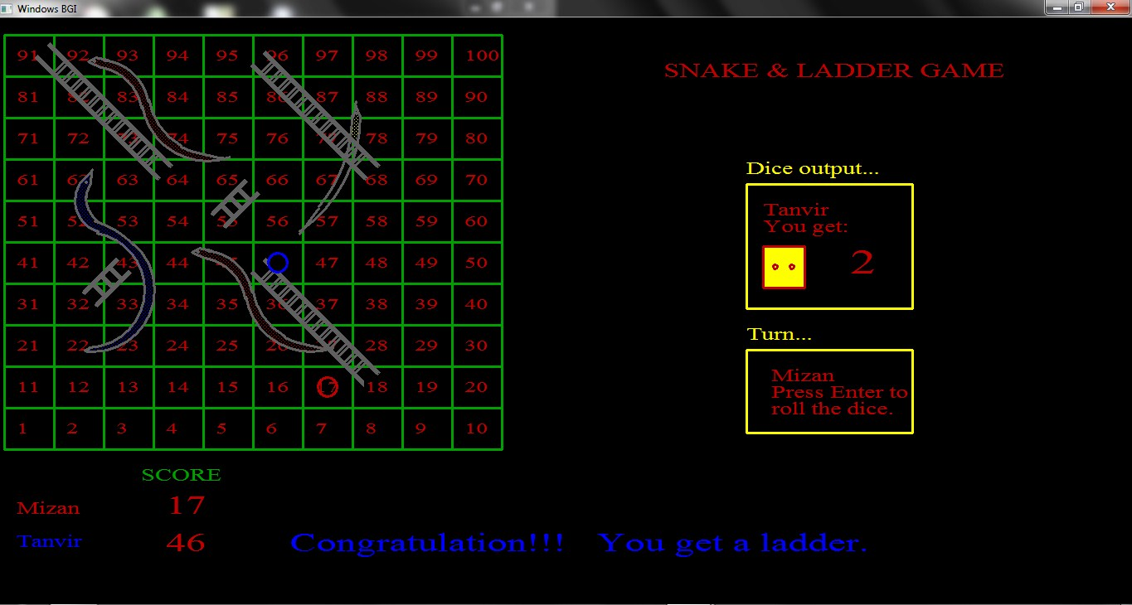
If you get a ladder then it will display a line containing “Congratulation!!! You get a ladder.” Beside your name in score card.

Slide 13
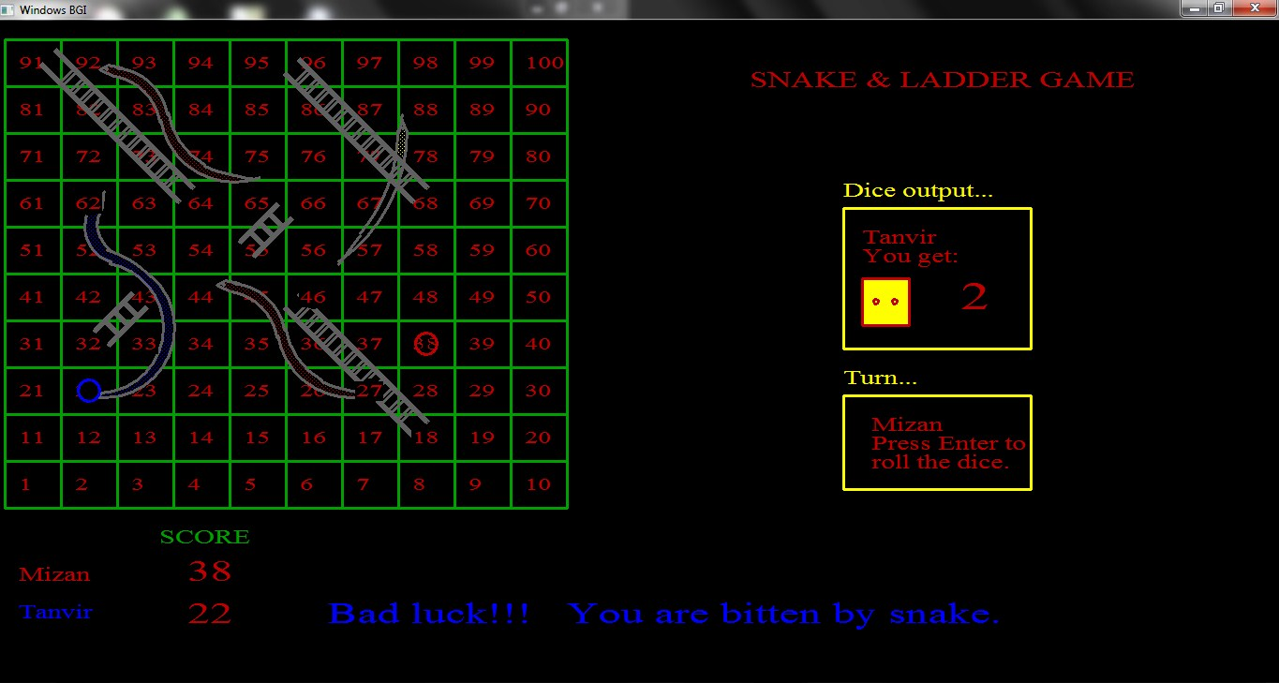
If you bitten by snake then a massage will be displayed containing “Bad luck!!! You are bitten by snake”.

Slide 14
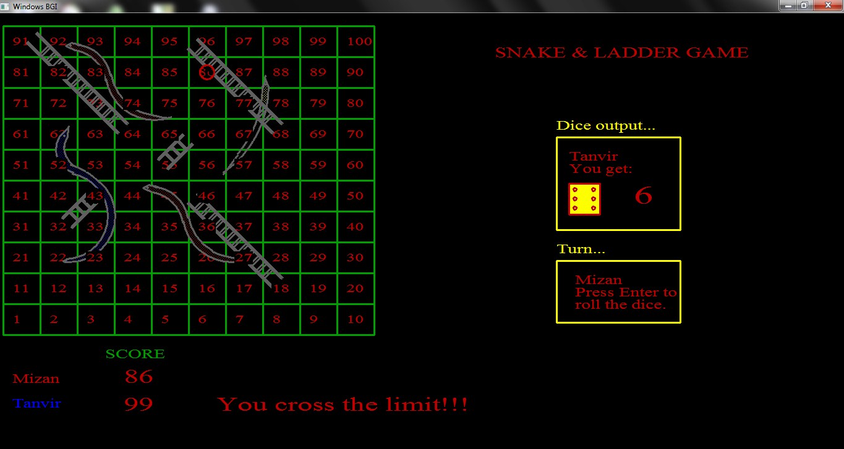
If your score be greater than 100 then, “You cross the limit.” Massage will be shown beside your name.

Slide 15
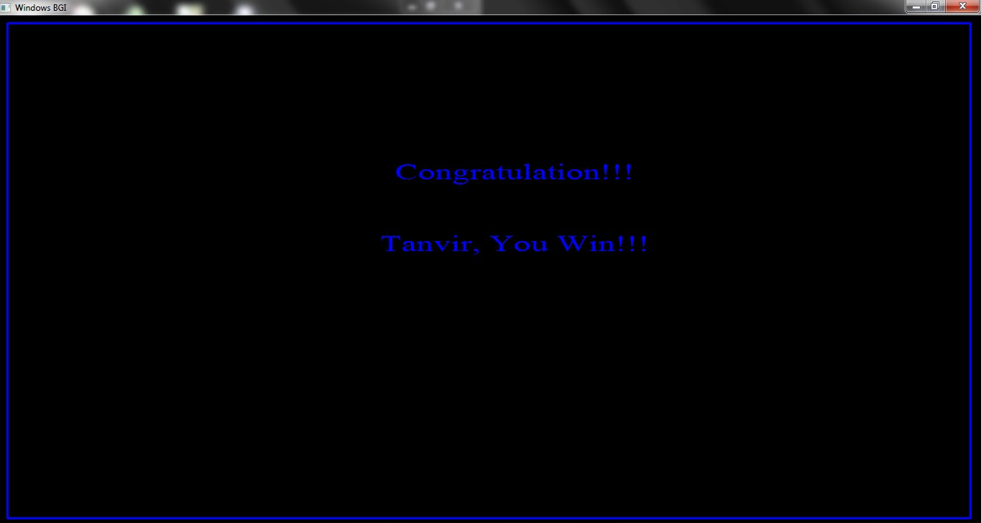
If you win then a massage will be printed on the screen containing
“Congratulation!!! (Your name), You Win.”

Slide 16
Limitation
As it is my first project there are some limitations in my project.
Limitations like:
➢ It does not show the rolling of dice.
➢ Snakes are not looking so good to see.

Slide 17
Future Work
In Future I want to add some other facilities in this project.
My future plans are
➢ It will show the rolling the dice.
➢ Graphics will be developed.
➢ I want to add ludu game with this project.

Slide 18
Discussion
C is a suitable language for newcomer in programming world. To build a game we have to work hard with different types of logic. It increases our thinking power. Beside logic it helps us to present ourselves to the users.
A game project increases our attraction to the programming. So that, programming will be a game or fun to us. We will be interested in programming very much, which is a very usefull side for us.
Besides, it will attract the newcomers in programming world. They will be encouraged, which is a positive sign for us.

Slide 19
Thanks All

